Slide 1
PORTFOLIO
E-mail id:-bipashadutta75@gmail.com
Mobile:- 8249669747

Slide 2



Work Sample

Slide 3






Slide 4

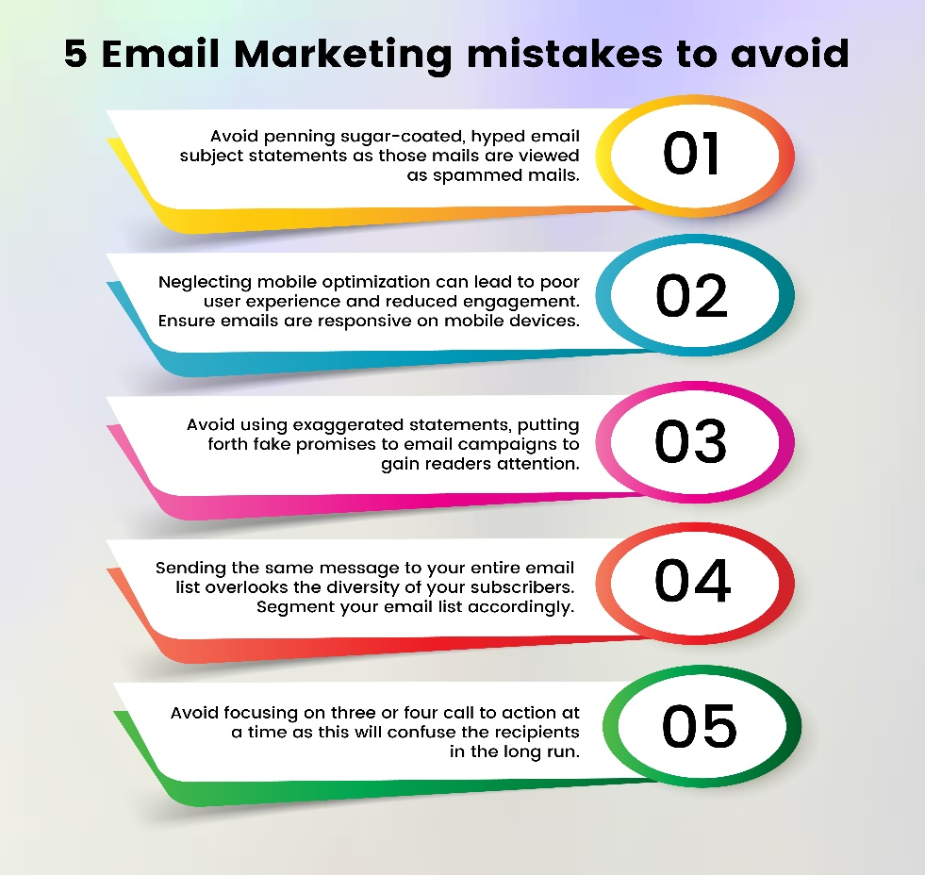
Infographics

Slide 5



Video Sample

Slide 6
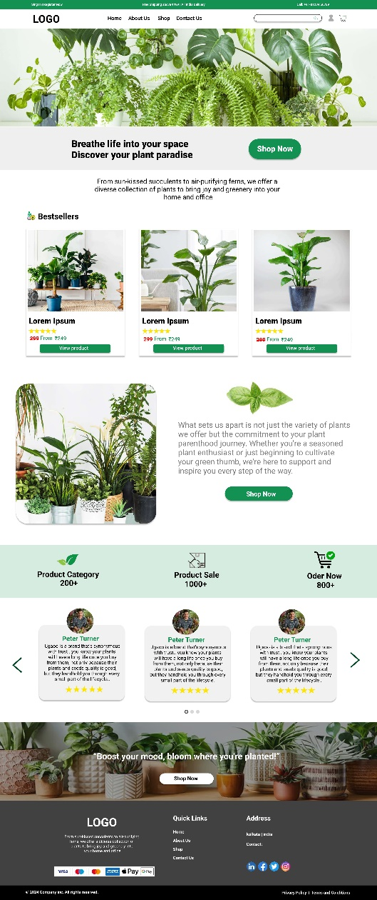


Website Sample

Slide 7


Logo Sample

